Slide 1
Welcome!
October 9, 2018
You are welcome to grab a lunch and find a seat at a table. Introduce yourselves to each other and we will get started at 12:30.
Notes:
Prior to start: Encourage people to get their lunch and be seated with the lunch…
12:30 Carrie to discuss – Goals on next page
Thank Adecco for lunch and PAST Foundation for providing the spaces☺

Slide 2
Goals for Today
Create a community of practice around work-based learning and pathway development in Central Ohio.
To debrief the Central Ohio Compact Symposium and the potential benefits for Central Ohio schools, businesses, higher education and communities.
To share the SuccessBound initiative and resources available.
To gather information regarding regional needs and aspirations for the future.
Notes:
Carrie to discuss

Slide 3
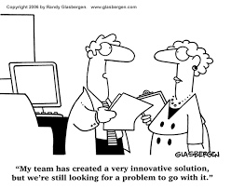
Focused Conversations
How does a focused gathering like the Central Ohio Compact Symposium impact local communities regarding economic development?
Notes:
12:35 Christine
Give instructions for getting their lunches and then returning to the table for focused discussion/dialogue
12:45 – 1:00 Christine
The ideas behind the question that we should walk around and prompt people to talk about are:
If we do not have forums like this for our local business and industry to participate in, how do we partner?
What happens when we don’t regularly communicate?
What could happen if everyone is going after the same business/industry? How can a coordinated regional effort assist?

Slide 4

Notes:
1:00 – 1:10
Adecco - Liane Makin

Slide 5
Funded by $2 Million “New Skills for Youth” Grant
Goal: “Students will chart their own life course in high-quality and high-demand pathways that lead to jobs before, during and after” post-secondary learning.
How do we accomplish this: Through the SuccessBound initiative!
Notes:
1:10 – 1:55 Nancy, Carrie, Dave
Insert slides as needed☺

Slide 6
SuccessBound
Fact Sheet
Notes:
Nancy

Slide 7
Some Targets for Development:
Alignment of career-focused pathways and industry-recognized credentials
Increase student career advising in at least 50% of Ohio schools
Increase student engagement in career planning through OhioMeansJobs with 30% more online student backpacks
Increase the number of students in high-demand pathways by 20%
Schools create and issue an OhioMeansJobs Readiness Seal by 10% of graduates.
Increase the percentage of students graduating with industry-recognized credential by 15%
Allow schools to integrate academic content so students may earn simultaneous credit in career-focused courses
SuccessBound becomes sustainable after Skills for Youth Grant money is gone.
Notes:
Nancy

Slide 8
SuccessBound Web Resources
New Skills for Youth
http://education.ohio.gov/Topics/New-Skills-for-Youth
SuccessBound
www.successbound.ohio.gov

Slide 9
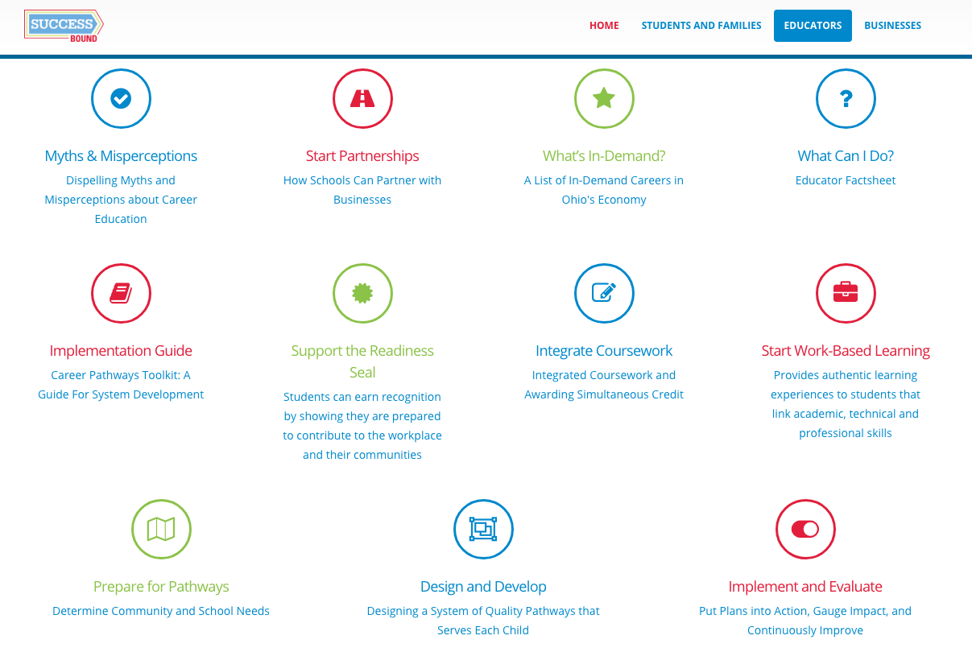
Regional Focus for SuccessBound Opportunities for Development
Notes:
These are the activity categories on this page.
1:55 – 2:15 Marcy Raymond
Small Group Facilitation Notes:
Each table will have cards made of each of the elements of the educator toolkit.
Groups at the table will sort the cards in order from the most needed improvement area for their context to least needed improvement area.
Selecting their top two - they will affix them to the top of a pre-printed poster paper (tape on the table) in the box provided.
Below each box are two columns. In the first column, you will write the strengths anticipated from having worked on this area more deeply in your school, district or community. These are forces FOR change. In the second column, articulate the things that have to change in your school, community or district. These are the forces that PULL against what you want. They could be beliefs, culture, practices, systems, inexperience, etc.
Have them list their community/school/district names at the bottom of the chart. We will use this to personalize the resources, help and assistance offered through Success Bound in Central Ohio.

Slide 10

Forces FOR Change Description of what is driving you to believe that work is needed | Forces HOLDING BACK Change Description of practices, systems, attitudes and beliefs that keep you from moving forward | Forces FOR Change Description of what is driving you to believe that work is needed | Forces HOLDING BACK Change Description of practices, systems, attitudes and beliefs that keep you from moving forward
Drivers
Impeding Factors
Notes:
1:55 – 2:15 Marcy Raymond
Small Group Facilitation Notes:
Each table will have cards made of each of the elements of the educator toolkit. You will divide into two groups at each table (3-4 people working together).
Groups at the table will sort the cards in order from the most needed improvement area for their context to least needed improvement area.
Selecting their top four - they will affix them to the a pre-printed poster paper (printed on sticky thingies) in the boxes provided.
Below each box are two columns. In the first column, you will write the strengths anticipated from having worked on this area more deeply in your school, district or community. These are forces FOR change. In the second column, articulate the things that have to change in your school, community or district. These are the forces that PULL against what you want. They could be beliefs, culture, practices, systems, inexperience, etc.
Have them list their community/school/district names at the bottom of the chart. We will use this to personalize the resources, help and assistance offered through Success Bound in Central Ohio.

Slide 11
Save the Date
November 9th, ESCCO -Follow up session based on regional discussion
State SuccessBound Conference December 6th
Central Ohio Regional SuccessBound Conference February 21
Notes:
2:15 – 2:30 Christine Galvin
Closing Remarks
Hopefully we have accomplished the goals for the day:
Create a Community of Practice around work-based learning practices and pathway development in Central Ohio.
To debrief the Central Ohio Compact Symposium and the potential benefits for Central Ohio schools, businesses, higher education and communities.
To share the Success Bound initiative and resources available.
To gather information regarding regional needs and aspirations for the future.

